Slide 1
News:
https://custompc.raspberrypi.org/articles/new-psu-standard-to-launch-this-year New PSU standard (ATX12VO)
This replaces all of the 3.5 and 5 volt power sources from a PSU, and ditches the 24 pin connector for a 10 pin one

Slide 2
The Essential OpenMP

Slide 3

Lecture 6: OpenMP
Review of HPC Models
Shared Memory: Performance concepts
Introduction to OpenMP
OpenMP: Runtime Library & Environment Variables
OpenMP: Data & Work sharing directives
OpenMP: Synchronization
OpenMP: Reduction
Synopsis of Commands

Slide 4

Topics
Review of HPC Models
Shared Memory: Performance concepts
Introduction to OpenMP
OpenMP: Runtime Library & Environment Variables
OpenMP: Data & Work sharing directives
OpenMP: Synchronization
OpenMP: Reduction
Synopsis of Commands

Slide 5
Where are we? (Take a deep breath…)
3 classes of parallel/distributed computing
Capacity
Capability
Cooperative
3 classes of parallel architectures (respectively)
Loosely coupled clusters and workstation farms
Tightly coupled vector, SIMD, SMP
Distributed memory MPPs (and some clusters)
3 classes of parallel execution models (respectively)
Workflow, throughput, SPMD (ssh)
Multithreaded with shared memory semantics (Pthreads)
Communicating Sequential Processes (sockets)
3 classes of programming models
Condor (Segment 1)
OpenMP (Segment 3)
MPI (Segment 2)

Slide 6
HPC Modalities
Modalities | Degree of Integration | Architectures | Execution Models | Programming Models
Capacity | Loosely Coupled | Clusters & Workstation farms | Workflow Throughput | Condor
Capability | Tightly Coupled | Vectors, SMP, SIMD | Shared Memory Multithreading | OpenMP
Cooperative | Medium | DM MPPs & Clusters | CSP | MPI
Notes:
Condor is framework for HPC throughput computing with coarse parallelism

Slide 7
Topics
Review of HPC Models
Shared Memory: Performance concepts
Introduction to OpenMP
OpenMP: Runtime Library & Environment Variables
OpenMP: Data & Work sharing directives
OpenMP: Synchronization
OpenMP: Reduction
Synopsis of Commands

Slide 8
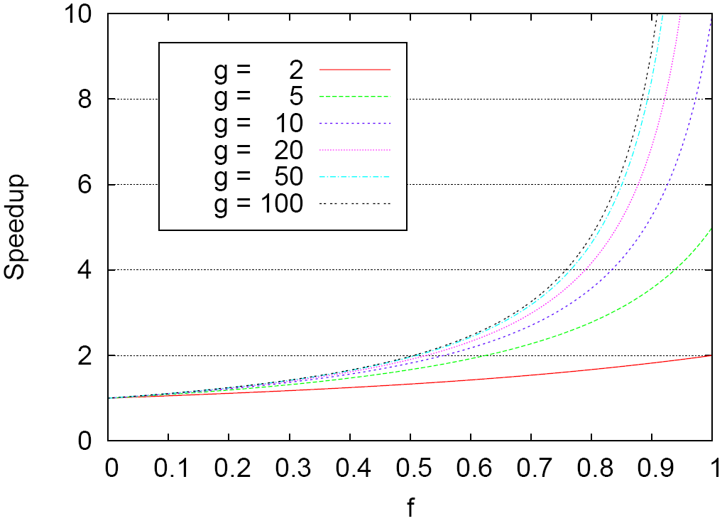
Amdahl’s Law
T_{O}
start
end
T_{A}
T_{F}
start
end
T_{F}/g

Slide 9
Performance: Caches & Locality
Temporal Locality is a property that if a program accesses a memory location, there is a much higher than random probability that the same location would be accessed again.
Spatial Locality is a property that if a program accesses a memory location, there is a much higher than random probability that the nearby locations would be accessed soon.
Spatial locality is usually easier to achieve than temporal locality
A couple of key factors affect the relationship between locality and scheduling :
Size of dataset being processed by each processor
How much reuse is present in the code processing a chunk of iterations.

Slide 10
Performance Shared Memory (OpenMP): Key Factors
Load Balancing :
mapping workloads with thread scheduling
Caches :
Write-through
Write-back
Locality :
Temporal Locality
Spatial Locality
How Locality affects scheduling algorithm selection
Synchronization :
Effect of critical sections on performance

Slide 11
Performance: Caches & Locality
Caches (Review) :
for a C statement :
a[i] = b[i]+c[i]
the system accesses the memory locations referenced by b[i] and c[i] to the processor, the result of the computation is subsequently stored in the memory location referenced by a[i]
Write-through caches: When a user writes some data, the data is immediately written back to the memory, thus maintaining the cache-memory consistency. In write through caches data in caches always reflect the data in the memory. One of the main issues in write through caches is the increase in system overhead required due to moving of large data between cache and memory.
Write-back caches : When a user writes some data, the data is stored in the cache and is not synchronized with the memory. Instead when the cache content is different than the memory content, a bit entry is made in the cache. While cleaning up caches the system checks for the entry in cache and if the bit is set the system writes the changes to the memory.

Slide 12
Topics
Review of HPC Models
Shared Memory: Performance concepts
Introduction to OpenMP
OpenMP: Runtime Library & Environment Variables
OpenMP: Data & Work sharing directives
OpenMP: Synchronization
OpenMP: Reduction
Synopsis of Commands

Slide 13
Introduction
OpenMP is :
an API (Application Programming Interface)
NOT a programming language
A set of compiler directives that help the application developer to parallelize their workload.
A collection of the directives, environment variables and the library routines
OpenMP is composed of the following main components :
Directives
Runtime library routines
Environment variables

Slide 14
Components of OpenMP
Directives
Parallel regions
Work sharing
Synchronization
Data scope attributes : private firstprivate last private shared reduction
Orphaning
Runtime library routines
Number of threads
Thread ID
Dynamic thread adjustment
Nested Parallelism
Timers
API for locking
Environment variables
Number of threads
Scheduling type
Dynamic thread adjustment
Nested Parallelism

Slide 15
Topics
Review of HPC Models
Shared Memory: Performance concepts
Introduction to OpenMP
OpenMP: Runtime Library & Environment Variables
OpenMP: Data & Work sharing directives
OpenMP: Synchronization
OpenMP: Reduction
Synopsis of Commands

Slide 16
Runtime Library Routines
Runtime library routines help manage parallel programs
Many runtime library routines have corresponding environment variables that can be controlled by the users
Runtime libraries can be accessed by including omp.h in applications that use OpenMP : #include <omp.h>
For example for calls like :
omp_get_num_threads(), (by which an openMP program determines the number of threads available for execution) can be controlled using an environment variable set at the command-line of a shell ($OMP_NUM_THREADS)
Some of the activities that the OpenMP libraries help manage are :
Determining the number of threads/processors
Scheduling policies to be used
General purpose locking and portable wall clock timing routines

Slide 17
Quick note
Most of the slides are written for OpenMP (and later MPI) with C/C++ and Fortran
There is an equivalent PyMP for python, and there are python libraries that are built using actual OpenMP
Numpy and Scipy and Pandas can use OpenMP as well (though the point in this course is for you to explicitly write the OpenMP yourself mostly).
Most of the core concepts are the same between all the libraries

Slide 18
OpenMP: Runtime Library
Function: | omp_get_num_threads()
C/ C++ | int omp_get_num_threads(void);
Fortran | integer function omp_get_num_threads()
Description: Returns the total number of threads currently in the group executing the parallel block from where it is called.
Function: | omp_get_thread_num()
C/ C++ | int omp_get_thread_num(void);
Fortran | integer function omp_get_thread_num()
Description: For the master thread, this function returns zero. For the child nodes the call returns an integer between 1 and omp_get_num_threads()-1 inclusive.

Slide 19
OpenMP Environment Variables
OpenMP provides 4 main environment variables for controlling execution of parallel codes:
OMP_NUM_THREADS – controls the parallelism of the OpenMP application
OMP_DYNAMIC – enables dynamic adjustment of number of threads for execution of parallel regions
OMP_SCHEDULE – controls the load distribution in loops such as do, for
OMP_NESTED – Enables nested parallelism in OpenMP applications

Slide 20
OpenMP Environment Variables
Environment Variable: | OMP_NUM_THREADS
Usage : bash/sh/ksh: csh/tcsh | OMP_NUM_THREADS n export OMP_NUM_THREADS=8 setenv OMP_NUM_THREADS 8
Description: Sets the number of threads to be used by the OpenMP program during execution.
Environment Variable: | OMP_DYNAMIC
Usage : bash/sh/ksh: csh/tcsh | OMP_DYNAMIC {TRUE|FALSE} export OMP_DYNAMIC=TRUE setenv OMP_DYNAMIC “TRUE”
Description: When this environment variable is set to TRUE the maximum number of threads available for use by the OpenMP program is n ($OMP_NUM_THREADS).

Slide 21
OpenMP Environment Variables
Environment Variable: | OMP_SCHEDULE
Usage : bash/sh/ksh: csh/tcsh | OMP_SCHEDULE “schedule,[chunk]” export OMP_SCHEDULE static,N/P setenv OMP_SCHEDULE=“GUIDED,4”
Description: Only applies to for and parallel for directives. This environment variable sets the schedule type and chunk size for all such loops. The chunk size can be provided as an integer number, the default being 1.
Environment Variable: | OMP_NESTED
Usage : bash/sh/ksh: csh/tcsh | OMP_NESTED {TRUE|FALSE} export OMP_NESTED FALSE setenv OMP_NESTED=“FALSE”
Description: Setting this environment variable to TRUE enables multi-threaded execution of inner parallel regions in nested parallel regions.

Slide 22
OpenMP: Basic Constructs
To invoke library routines in C/C++ add
#include <omp.h> near the top of your code
OpenMP Execution Model (FORK/JOIN):
Sequential Part (master thread)
Parallel Region (FORK : group of threads)
Sequential Part (JOIN: master thread)
Parallel Region (FORK: group of threads)
Sequential Part (JOIN : master thread)
C / C++ :
#pragma omp parallel
{
parallel block
} /* omp end parallel */

Slide 23
HelloWorld in OpenMP
#include <omp.h>
main ()
{
int nthreads, tid;
#pragma omp parallel private(nthreads, tid)
{
tid = omp_get_thread_num();
printf("Hello World from thread = %d\n", tid);
if (tid == 0)
{
nthreads = omp_get_num_threads();
printf("Number of threads = %d\n", nthreads);
}
}
}
Non shared copies of data for each thread
OpenMP directive to indicate START segment to be parallelized
Code segment that will be executed in parallel
OpenMP directive to indicate END segment to be parallelized

Slide 24
OpenMP Execution
On encountering the C construct #pragma omp parallel{, n-1 extra threads are created
omp_get_thread_num() returns a unique identifier for each thread that can be utilized. The value returned by this call is between 0 and (OMP_NUM_THREADS – 1)
omp_get_num_threads() returns the total number of threads involved in the parallel section of the program
Code after the parallel directive is executed independently on each of the n threads.
On encountering the C construct } (corresponding to #pragma omp parallel{ ), indicates the end of parallel execution of the code segment, the n-1 extra threads are deactivated and normal sequential execution begins.

Slide 25
Compiling OpenMP Programs
C :
Case sensitive directives
Syntax :
#pragma omp directive [clause [clause]..]
Compiling OpenMP source code :
(GNU C compiler) : gcc –fopenmp –o exec_name file_name.c
(Intel C compiler) : icc –o exe_file_name –openmp file_name.c
Fortran :
Case insensitive directives
Syntax :
!$OMP directive [clause[[,] clause]…] (free format)
!$OMP / C$OMP / *$OMP directive [clause[[,] clause]…] (free format)
Compiling OpenMP source code :
(GNU Fortran compiler) : gfortran –fopenmp –o exec_name file_name.f95
(Intel Fortran compiler) : ifort -o exe_file_name –openmp file_name.f

Slide 26
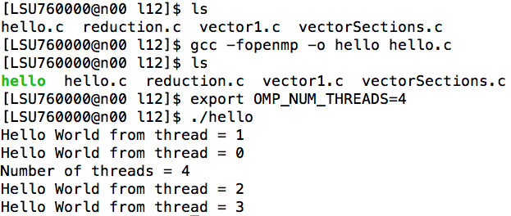
DEMO: Hello World

Slide 27
Topics
Review of HPC Models
Shared Memory: Performance concepts
Introduction to OpenMP
OpenMP: Runtime Library & Environment Variables
OpenMP: Data & Work sharing directives
OpenMP: Synchronization
OpenMP: Reduction
Synopsis of Commands

Slide 28
OpenMP: Data Environment
OpenMP program always begins with a single thread of control – master thread
Context associated with the master thread is also known as the Data Environment.
Context is comprised of :
Global variables
Automatic variables
Dynamically allocated variables
Context of the master thread remains valid throughout the execution of the program
The OpenMP parallel construct may be used to either share a single copy of the context with all the threads or provide each of the threads with a private copy of the context.
The sharing of Context can be performed at various levels of granularity
Select variables from a context can be shared while keeping the context private etc.

Slide 29
OpenMP Data Environment
OpenMP data scoping clauses allow a programmer to decide a variable’s execution context (should a variable be shared or private.)
3 main data scoping clauses in OpenMP (Shared, Private, Reduction) :
Shared :
A variable will have a single storage location in memory for the duration of the parallel construct, i.e. references to a variable by different threads access the same memory location.
That part of the memory is shared among the threads involved, hence modifications to the variable can be made using simple read/write operations
Modifications to the variable by different threads is managed by underlying shared memory mechanisms
Private :
A variable will have a separate storage location in memory for each of the threads involved for the duration of the parallel construct.
All read/write operations by the thread will affect the thread’s private copy of the variable .
Reduction :
Exhibit both shared and private storage behavior. Usually used on objects that are the target of arithmetic reduction.
Example : summation of local variables at the end of a parallel construct

Slide 30
OpenMP Work-Sharing Directives
Work sharing constructs divide the execution of the enclosed block of code among the group of threads.
They do not launch new threads.
No implied barrier on entry
Implicit barrier at the end of work-sharing construct
Commonly used Work Sharing constructs :
for directive (C/C++ ; equivalent DO construct available in Fortran but will not be covered here) : shares iterations of a loop across a group of threads
sections directive : breaks work into separate sections between the group of threads; such that each thread independently executes a section of the work.
critical directive: serializes a section of code

Slide 31
OpenMP Schedule Clause
The schedule clause defines how the iterations of a loop are divided among a group of threads
static : iterations are divided into pieces of size chunk and are statically assigned to each of the threads in a round robin fashion
dynamic : iterations divided into pieces of size chunk and dynamically assigned to a group of threads. After a thread finishes processing a chunk, it is dynamically assigned the next set of iterations.
guided : For a chunk of size of 1, the size of each chunk is proportional to the number of unassigned iterations divided by the number of threads, decreasing to 1. For a chunk with value k, the same algorithm is used for determining the chunk size with the constraint that no chunk should have less than k chunks except the last chunk.
Default schedule is implementation specific while the default chunk size is usually 1

Slide 32
OpenMP for directive
for directive helps share iterations of a loop between a group of threads
If nowait is specified then the threads do not wait for synchronization at the end of a parallel loop
The schedule clause describes how iterations of a loop are divided among the threads in the team (discussed in detail in the next few slides)
fork
do / for loop
join
#pragma omp parallel
{
p=5;
#pragma omp for
for (i=0; i<24; i++)
x[i]=y[i]+p*(i+3)
…
…
} /* omp end parallel */
p=5
p=5
…
p=5
i =
0,4
i= 5,9
…
i= 20,24
x[i]=y[i]+…
x[i]=y[i]+…
…
x[i]=y[i]+…

Slide 33
Simple Loop Parallelization
#pragma omp parallel for
for (i=0; i<n; i++)
z( i) = a*x(i)+y
Master thread executing serial portion of the code
Master thread encounters parallel for loop and creates worker threads
Master and worker threads divide iterations of the for loop and execute them concurrently
Implicit barrier: wait for all threads to finish their executions
Master thread executing serial portion of the code resumes and slave threads are discarded

Slide 34
Example: OpenMP work sharing Constructs
#include <omp.h>
#define N 16
main ()
{
int i, chunk;
float a[N], b[N], c[N];
for (i=0; i < N; i++)
a[i] = b[i] = i * 1.0;
chunk = 4;
printf("a[i] + b[i] = c[i] \n");
#pragma omp parallel shared(a,b,c,chunk) private(i)
{
#pragma omp for schedule(dynamic,chunk) nowait
for (i=0; i < N; i++)
c[i] = a[i] + b[i];
} /* end of parallel section */
for (i=0; i < N; i++)
printf(" %f + %f = %f \n",a[i],b[i],c[i]);
}
Initializing the vectors a[i], b[i]
Instructing the runtime environment that a,b,c,chunk are shared variables and I is a private variable
The nowait ensures that the child threads donot synchronize once their work is completed
Load balancing the threads using a DYNAMIC policy where array is divided into chunks of 4 and assigned to the threads
Modified from examples posted on: https://computing.llnl.gov/tutorials/openMP/

Slide 35
OpenMP sections directive
sections directive is a non iterative work sharing construct.
Independent section of code are nested within a sections directive
It specifies enclosed section of codes between different threads
Code enclosed within a section directive is executed by a thread within the pool of threads
fork
join
#pragma omp parallel private(p)
{
#pragma omp sections
{{ a=…;
b=…;}
#pragma omp section
{ p=…;
q=…;}
#pragma omp section
{ x=…;
y=…;}
} /* omp end sections */
} /* omp end parallel */
a =
p =
x =
b =
q =
y =

Slide 36
Understanding variables in OpenMP
#pragma omp parallel for
for (i=0; i<n; i++)
z[i] = a*x[i]+y
z[ ]
a
x[ ]
y
n
i
Shared variable z is modified by multiple threads
Each iteration reads the scalar variables a and y and the array element x[i]
a,y,x can be read concurrently as their values remain unchanged.
Each iteration writes to a distinct element of z[i] over the index range. Hence write operations can be carried out concurrently with each iteration writing to a distinct array index and memory location
The parallel for directive in OpenMP ensures that the for loop index value (i in this case) is private to each thread.
i
i
i
i

Slide 37
Example: OpenMP Sections
#include <omp.h>
#define N 16
main (){
int i;
float a[N], b[N], c[N], d[N];
for (i=0; i < N; i++)
a[i] = b[i] = i * 1.5;
#pragma omp parallel shared(a,b,c,d) private(i)
{
#pragma omp sections nowait
{
#pragma omp section
for (i=0; i < N; i++)
c[i] = a[i] + b[i];
#pragma omp section
for (i=0; i < N; i++)
d[i] = a[i] * b[i];
} /* end of sections */
} /* end of parallel section */
…
Sections construct that encloses the section calls
Section : that computes the sum of the 2 vectors
Section : that computes the product of the 2 vectors
Modified from examples posted on: https://computing.llnl.gov/tutorials/openMP/

Slide 38
Topics
Review of HPC Models
Shared Memory: Performance concepts
Introduction to OpenMP
OpenMP: Runtime Library & Environment Variables
OpenMP: Data & Work sharing directives
OpenMP: Synchronization
OpenMP: Reduction
Synopsis of Commands

Slide 39
Thread Synchronization
“communication” mainly through read write operations on shared variables
Synchronization defines the mechanisms that help in coordinating execution of multiple threads (that use a shared context) in a parallel program.
Without synchronization, multiple threads accessing shared memory location may cause conflicts by :
Simultaneously attempting to modify the same location
One thread attempting to read a memory location while another thread is updating the same location.
Synchronization helps by providing explicit coordination between multiple threads.
Two main forms of synchronization :
Implicit event synchronization
Explicit synchronization – critical, master directives in OpenMP

Slide 40
Basic Types of Synchronization
Explicit Synchronization via mutual exclusion
Controls access to the shared variable by providing a thread exclusive access to the memory location for the duration of its construct.
Critical directive of OpenMP provides mutual exclusion
Event Synchronization
Signals occurrence of an event across multiple threads.
Barrier directives in OpenMP provide the simplest form of event synchronization
The barrier directive defines a point in a parallel program where each thread waits for all other threads to arrive. This helps to ensure that all threads have executed the same code in parallel upto the barrier.
Once all threads arrive at the point, the threads can continue execution past the barrier.
Additional synchronization mechanisms available in OpenMP

Slide 41
OpenMP Synchronization: master
The master directive in OpenMP marks a block of code that gets executed on a single thread.
The rest of the threads in the group ignore the portion of code marked by the master directive
Example
#pragma omp master
structured block
Race Condition :
Two asynchronous threads access the same shared variable and at least one modifies the variable and the sequence of operations is undefined . Result of these asynchronous operations depends on detailed timing of the individual threads of the group.

Slide 42
OpenMP critical directive: Explicit Synchronization
Race conditions can be avoided by controlling access to shared variables by allowing threads to have exclusive access to the variables
Exclusive access to shared variables allows the thread to atomically perform read, modify and update operations on the variable.
Mutual exclusion synchronization is provided by the critical directive of OpenMP
Code block within the critical region defined by critical /end critical directives can be executed only by one thread at a time.
Other threads in the group must wait until the current thread exits the critical region. Thus only one thread can manipulate values in the critical region.
int x
x=0;
#pragma omp parallel shared(x)
{
#pragma omp critical
x = 2*x + 1;
} /* omp end parallel */
fork
- critical region
join

Slide 43
Simple Example: critical
cnt=0
f=7
cnt = 0;
f = 7;
#pragma omp parallel
{
#pragma omp for
for (i=0;i<20;i++){
if(b[i] == 0){
#pragma omp critical
cnt ++;
} /* end if */
a[i]=b[i]+f*(i+1);
} /* end for */
} /* omp end parallel */
i =0,4
i=5,9
i= 10,14
i= 20,24
if …
if …
if …
i= 20,24
cnt++
cnt++
a[i]=b[i]+…
a[i]=b[i]+…
cnt++
cnt++
a[i]=b[i]+…
a[i]=b[i]+…

Slide 44
Topics
Review of HPC Models
Shared Memory: Performance concepts
Introduction to OpenMP
OpenMP: Runtime Library & Environment Variables
OpenMP: Data & Work sharing directives
OpenMP: Synchronization
OpenMP: Reduction
Synopsis of Commands

Slide 45
OpenMP: Reduction
performs reduction on shared variables in list based on the operator provided.
for C/C++ operator can be any one of :
+, *, -, ^, |, ||, & or &&
At the end of a reduction, the shared variable contains the result obtained upon combination of the list of variables processed using the operator specified.
sum=0
sum = 0.0
#pragma omp parallel for reduction(+:sum)
for (i=0; i < 20; i++)
sum = sum + (a[i] * b[i]);
i=0,4
i=5,9
i=10,14
i=15,19
sum=..
sum=..
sum=..
sum=..
∑sum
sum=0

Slide 46
Example: Reduction
#include <omp.h>
main () {
int i, n, chunk;
float a[16], b[16], result;
n = 16;
chunk = 4;
result = 0.0;
for (i=0; i < n; i++)
{
a[i] = i * 1.0;
b[i] = i * 2.0;
}
#pragma omp parallel for default(shared) private(i) \
schedule(static,chunk) reduction(+:result)
for (i=0; i < n; i++)
result = result + (a[i] * b[i]);
printf("Final result= %f\n",result);
}
Reduction example with summation where the result of the reduction operation stores the dotproduct of two vectors
∑a[i]*b[i]
SRC : https://computing.llnl.gov/tutorials/openMP/

Slide 47
Topics
Review of HPC Models
Shared Memory: Performance concepts
Introduction to OpenMP
OpenMP: Runtime Library & Environment Variables
OpenMP: Data & Work sharing directives
OpenMP: Synchronization
OpenMP: Reduction
Synopsis of Commands

Slide 48
Synopsis of Commands
How to invoke OpenMP runtime systems #pragma omp parallel
The interplay between OpenMP environment variables and runtime system (omp_get_num_threads(), omp_get_thread_num())
Shared data directives such as shared, private and reduction
Basic flow control using sections, for
Fundamentals of synchronization using critical directive and critical section.
And directives used for the OpenMP programming part of the problem set.

